Slide 1

Welcome!
Vinod Anantharaman
Director of Strategy & Biz Mgmt., IMML

Slide 2
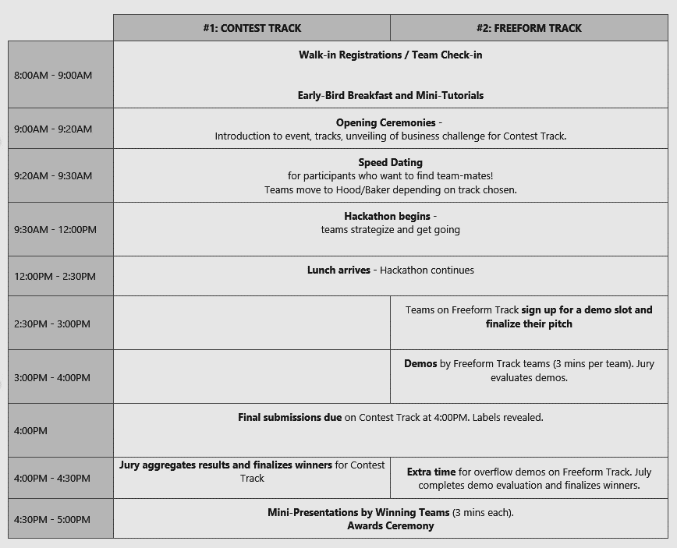

Slide 3
Mini-Tutorials – TLC
Mona Habib, Research PM

Slide 4
TLC – A Machine Learning Toolkit
What is TLC?
ML experimentation platform
Diverse: many tasks, learners, easy to plug in
Efficient/scalable: multi-core, GPUs, Scope
Multi-environment: local, HPC, Aether, Cosmos, CloudML Studio
Use in command line, GUI, .Net API
Practical: parameter sweeps, data parsing options
Experiment management and result analysis
Unified data representation & normalization
Unified evaluation
Extensible via API

Slide 5
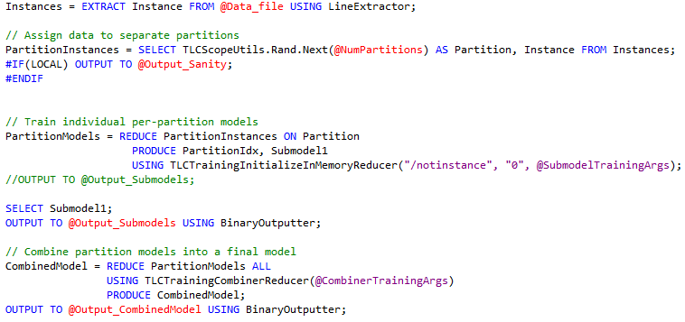
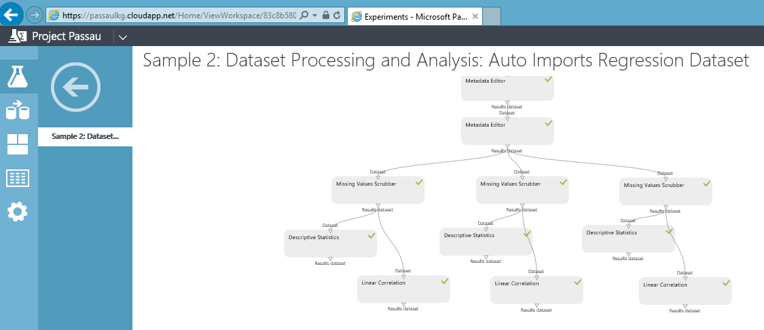
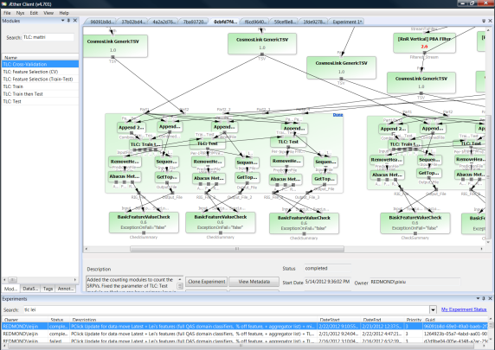
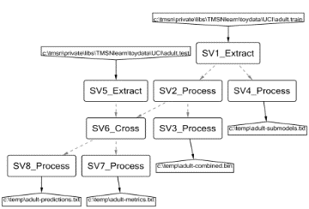
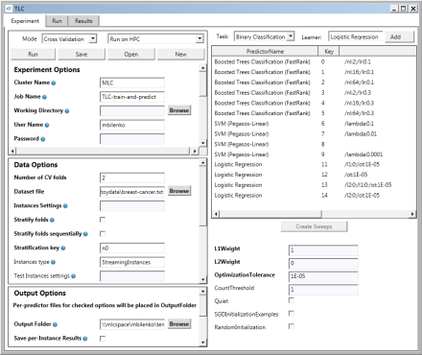
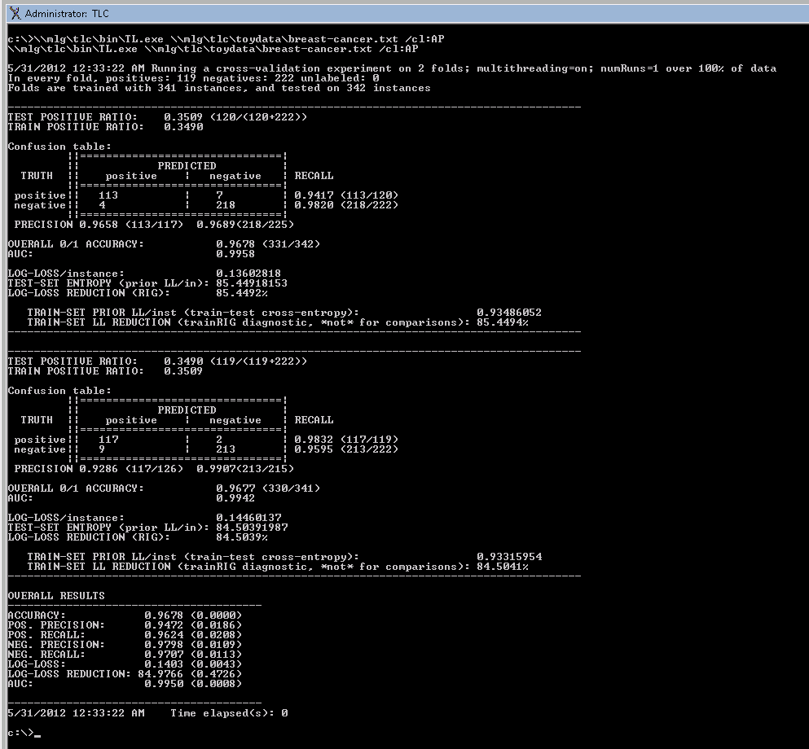
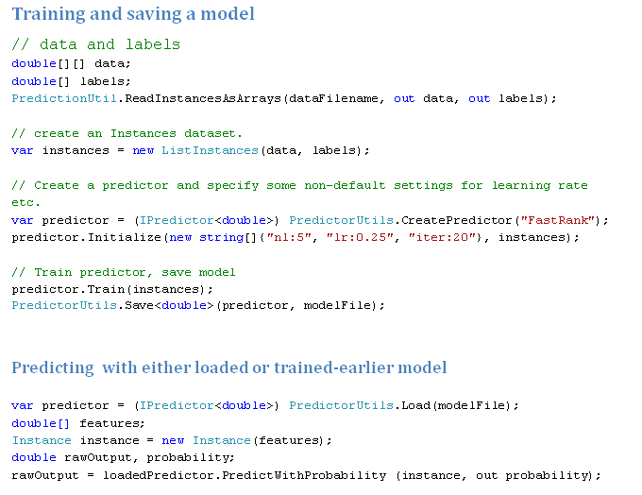
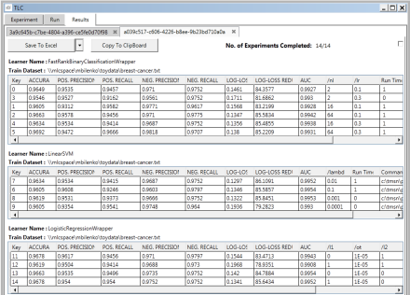
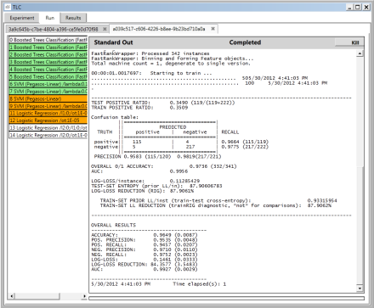
ML where you need it
Cosmos
CloudML Studio
AEther
GUI (local/HPC)
Command-line
.NET API

Slide 6
Learning Tasks
Learning in TLC
Classification (binary and multiclass), Regression, Ranking
Multiclass: One-vs-all, Pairwise coupling, native (LR and NN)
Model comparison
Basic Error Analysis
Learners:
Linear learners: Averaged Perceptron, Logistic Regression, SVMs
Boosted Decision Trees
Random Forests
Basic and Deep Neural Networks
Ensembles: Stacking, boosting, bagging
Meta learners: Strato learner, learning with counts
Wrappers for VW, Bramble, HNN (discriminitave GMM)

Slide 7
Data Ingestion
TLC supports various data formats
Text
Binary
Bing extraction
Raw image data
VW data
SQL and others
Custom data formats
Dense and sparse data
Numeric, categorical, named, attribute, and text features

Slide 8
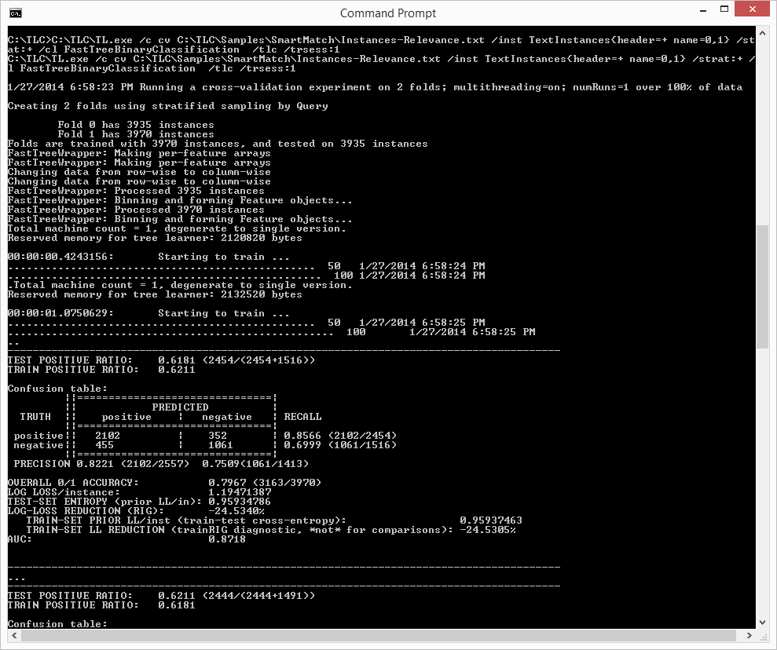
Command Line: TL.exe
TL.exe ?
TL.exe LogisticRegression ?

Slide 9
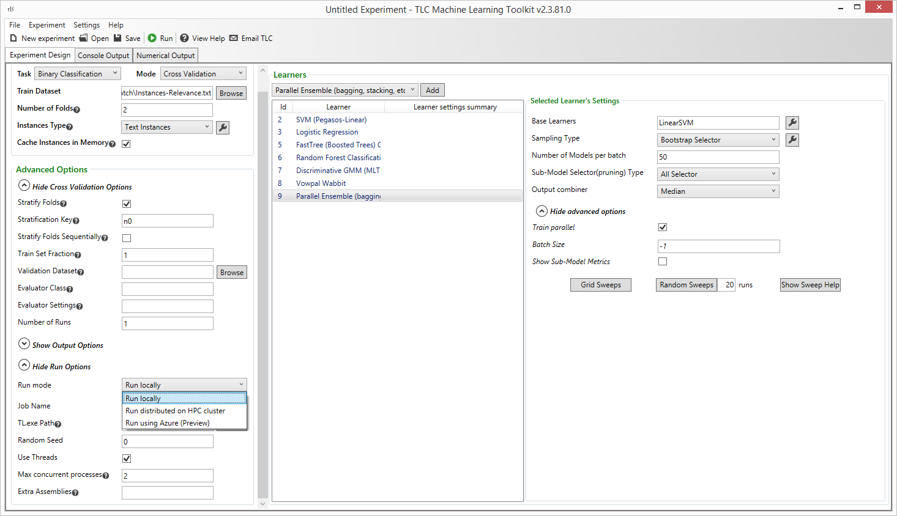
TLC GUI Experimentation Tool
Choose where to run experiment(s)
Run on the local machine
Run on HPC cluster
Run in Azure

Slide 10
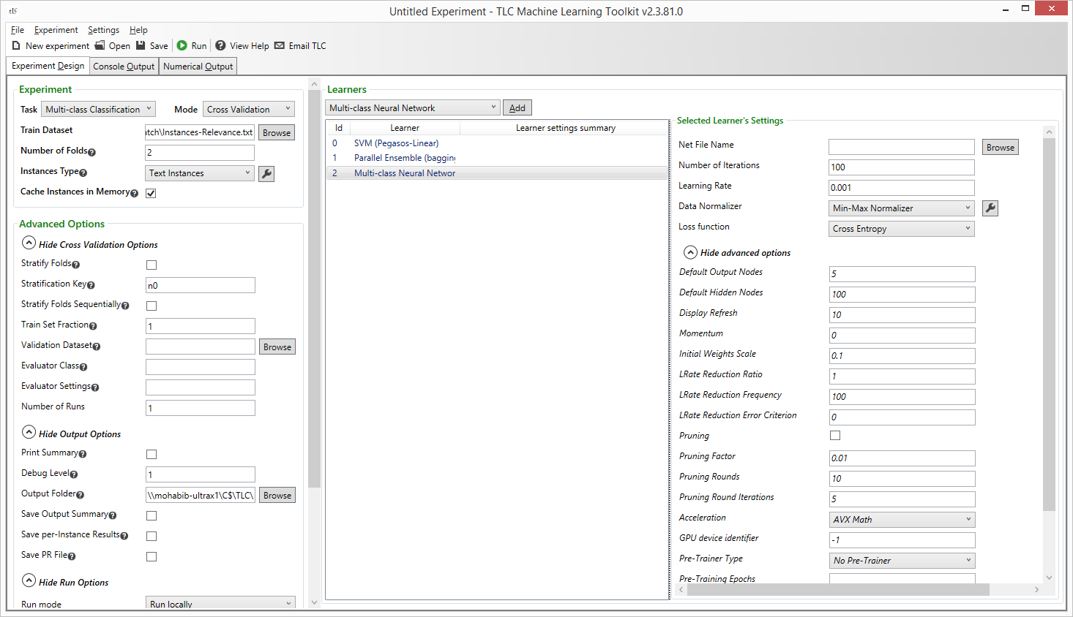
TLC GUI - Experiment Design
Task and Mode Selection
Input Datasets Definition
Output Options
Run Environment Options
Learner(s) Selection
Choose one or more learners to run for the same task/mode/data defined in left pane
Learner Parameter Settings
Define parameters or use defaults
Parameter sweeps: Suggested parameters, Random or Grid sweeps

Slide 11
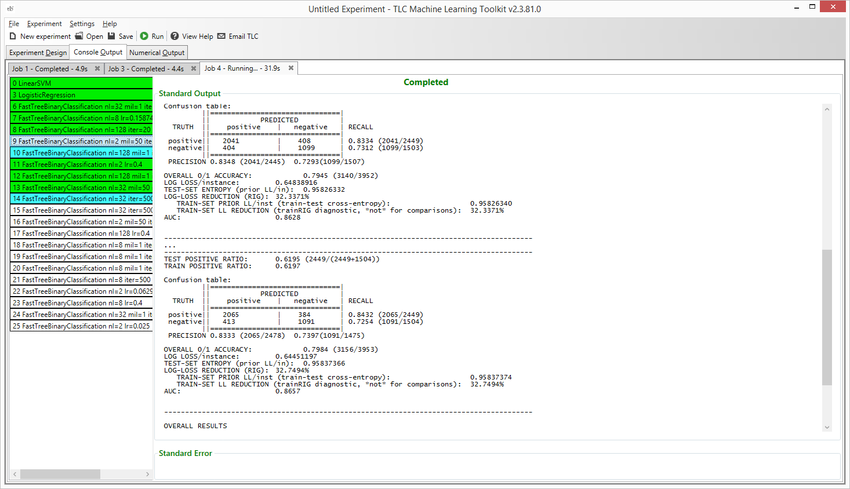
TLC GUI: Console Output
Detailed standard output and error for each learner in the experiment
Report of performance metrics
View status of each learner

Slide 12
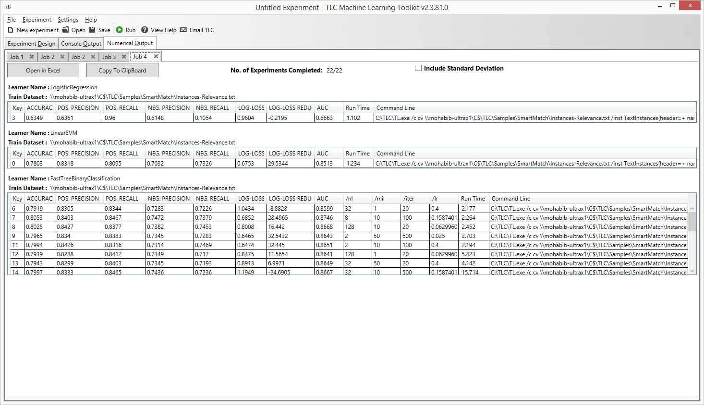
TLC GUI: Numerical Results
Tabular view of performance metrics, grouped by learner type
Accuracy, Positive Precision/Recall, Negative Precision/Recall, Log-Loss, AUC for classification tasks

Slide 13
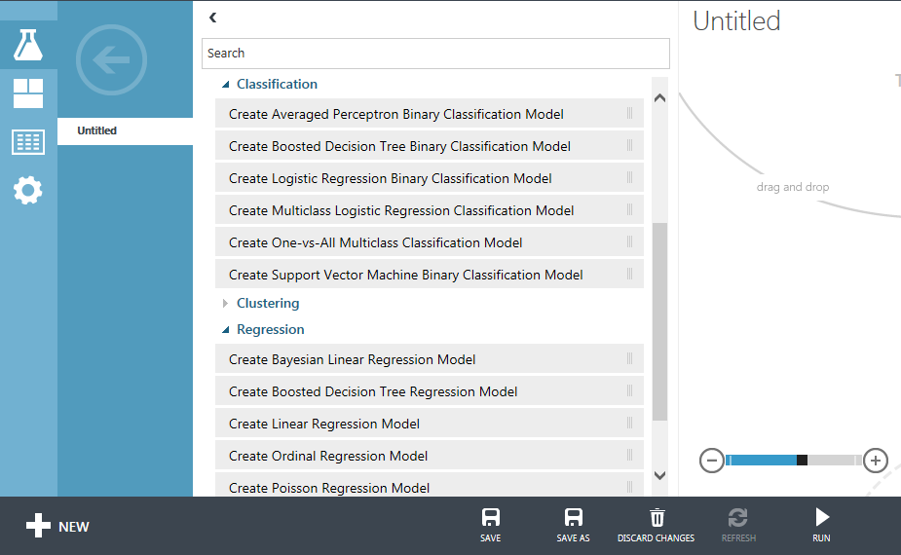
TLC in CloudML Studio
CloudML Studio uses TLC for most of its classification and regression algorithms

Slide 14
Inspecting ML Models
Per-instance output/probability
Save PR and ROC curves
Error Explorer
Slice and dice the confusion matrix, examine different thresholds, 2D and 3D debugging figures, and more
Tree Visualizer
Visual navigation of boosted trees
Explore features, instances, and more

Slide 15
Resources and Contacts
Downloads and help: http://tlc
Source available for download
TLC User’s Manual
NN Definition Language Manual: TNL
TLC Workshop
DLs:
Release news: tlcnews
User discussion: tlcdisc
Team support: tlcsupp

Slide 16
TLC Demo
Mona Habib

Slide 17
Sample Application – Predicting Income Level
Goal
Predict whether an adult’s income is >50K or <=50K using census income data.
Data sources
Census Income Dataset
Source: UCI Machine Learning Repository
Dataset Description
http://archive.ics.uci.edu/ml/machine-learning-databases/adult/adult.names
Numeric fields: age, fnlwgt, education-num, capital-gain, capital-loss, hours-per-week.
Categorical fields: workclass, education, marital-status, occupation, relationship, race, sex, native-country.

Slide 18
Census Income Dataset
String fields are categorical
Wonder if it’d impact the model performance
Potential target leaks: workclass, fnlwgt, occupation

Slide 19
Thanks!

